Slide 1

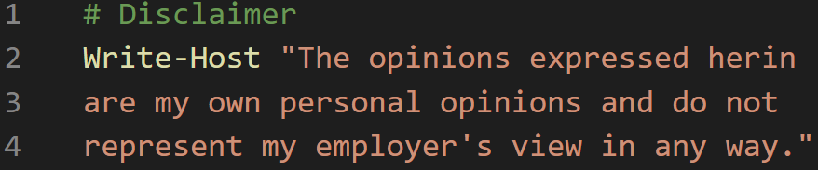

Community Tools & Tricks
Rudy Bankson
Sr Ent Systems Engineer @ An Airline People Love!
@Physx51 get-itguy.com
NWSCUG

Slide 2

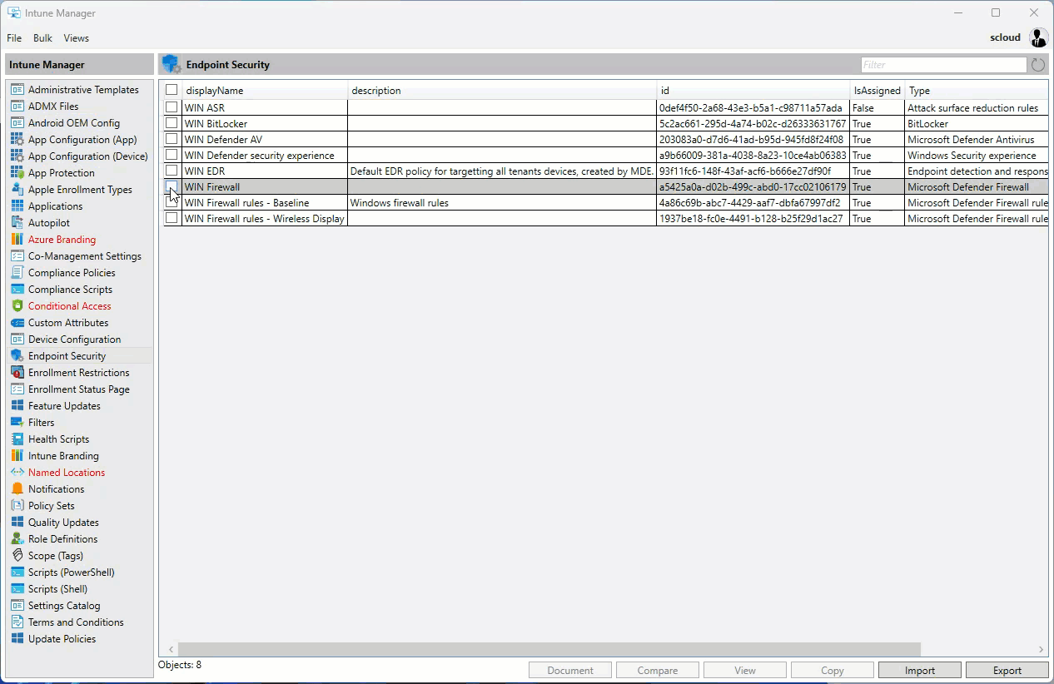
Intune Management by Micke Karlsson (Twitter @Micke_K_72) (Github https://github.com/micke-k)
Copy, export, import, delete, document, and compare objects in Intune
PowerShell based with WPF GUI
Uses Microsoft Authentication Library (MSAL), Graph APIs, and Azure Management APIs
BACKUP YOUR INTUNE ENVIRONMENT!
Silent batch job (beta) can be configured to automate backups
https://github.com/Micke-K/IntuneManagement

Slide 3

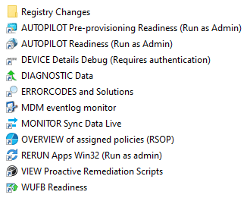
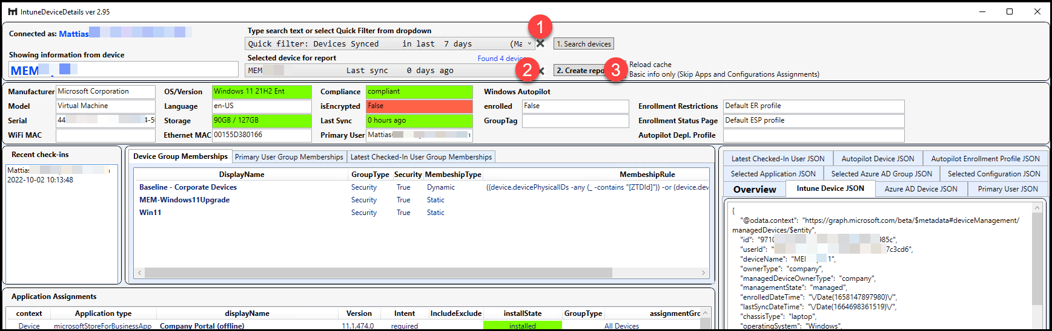
Intune Debug Toolkit by MSEndpointMgr https://msendpointmgr.com/intune-debug-toolkit/
Troubleshoot Intune client issues
Real-time monitoring of sync data
Debug GPO to see changes in the last 36 hours and details about each change
Great for GPO vs CSP troubleshooting
Overview of assigned policies (like RSOP)
Rerun Win32 Apps
WUfB Readiness tool
https://github.com/MSEndpointMgr/IntuneDebugToolkit

Slide 4

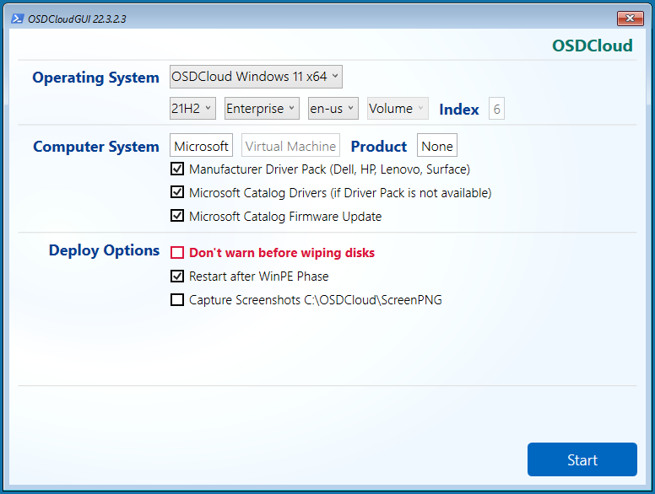
OSDCloud by David Segura (Twitter @Seguraosd) (https://www.osdcloud.com/)
Deploys Windows 10 or 11 over the internet using OSD PowerShell Module
Build a WinPE disk or USB to boot
Content for Windows comes from MS, drivers come from vendors or MS if not available from vendors
Works on pretty much any hardware
Great option to get a “factory Windows” build on a computer to enroll in Autopilot
Send @SeguraOSD a thank you on Twitter… this is a premium product for free

Slide 5

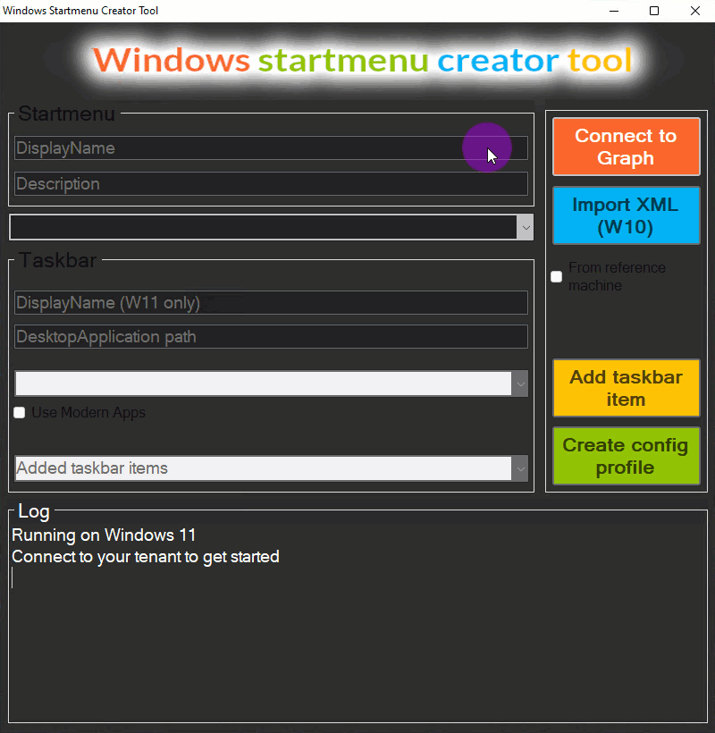
Windows Start Menu Creator Tool by Nicklas Ahlberg (Twitter @AhlbergNicklas) (https://github.com/NicklasAhlberg)
Creates Start Menu XML from a reference machine and will upload it to Intune for you
Creates XML, connects to Intune, uploads XML, creates policy to deploy
Check out GitHub page for Pre-Reqs including PS execution policy and Intune Graph PS module
Supports Windows 10 and Windows 11
Supports customizations to both the Start Menu and Taskbar

Slide 6
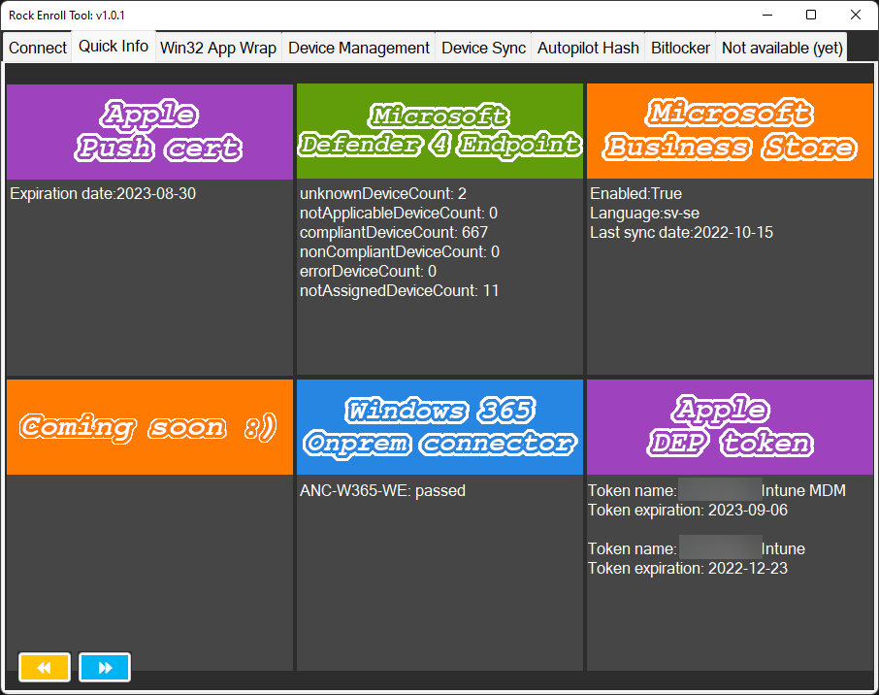
Rock Enroll Tool by Nicklas Ahlberg (Twitter @AhlbergNicklas) (https://github.com/NicklasAhlberg)
Swiss Army Knife of Intune
Connect to your tenant and get a quick glance at the Apple Push cert, MS Defender for Endpoint, Microsoft Business Store (RIP), Windows 365 On-Prem Connector, and Apple DEP token
Intune App Wrapper GUI, Device Management, Device Sync, Autopilot Hash tool, BitLocker Recovery Key viewer
https://www.rockenroll.tech/2022/10/23/rock-enroll-tool/
https://github.com/NicklasAhlberg/RockEnrollTool/releases/

Slide 7
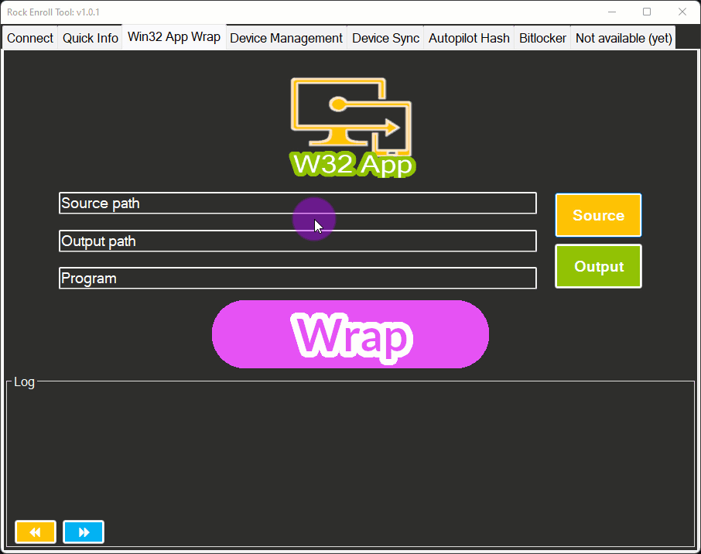
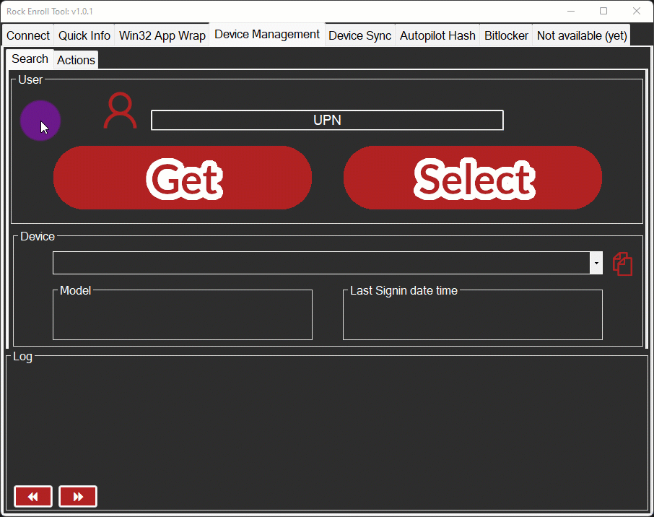
Rock Enroll Tool by Nicklas Ahlberg (Twitter @AhlbergNicklas) (https://github.com/NicklasAhlberg)

Slide 8
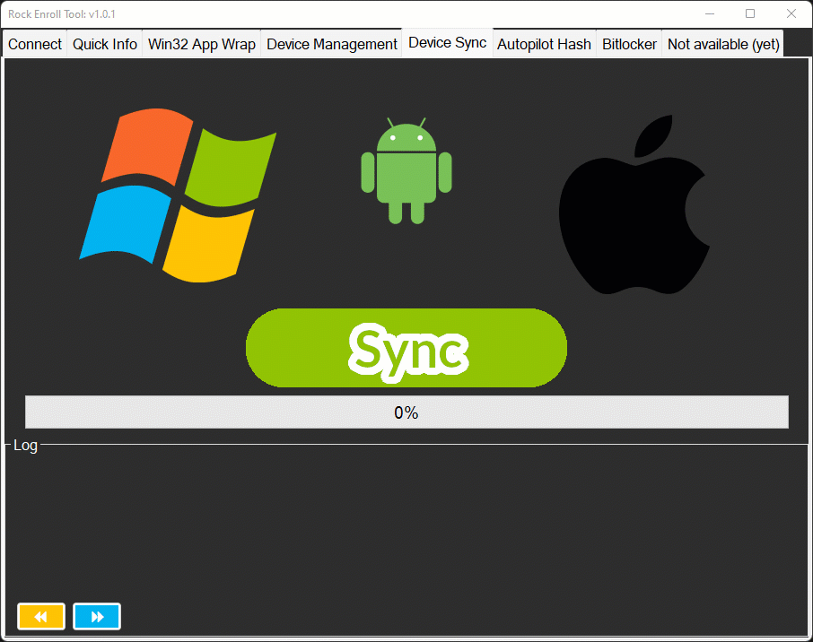
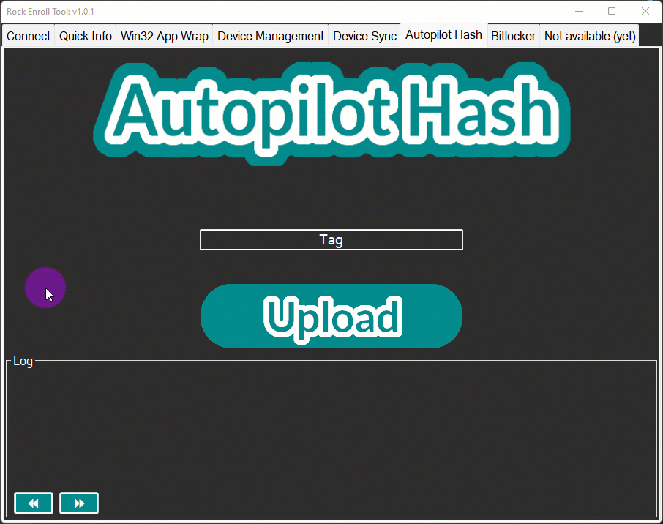
Rock Enroll Tool by Nicklas Ahlberg (Twitter @AhlbergNicklas) (https://github.com/NicklasAhlberg)

Slide 9

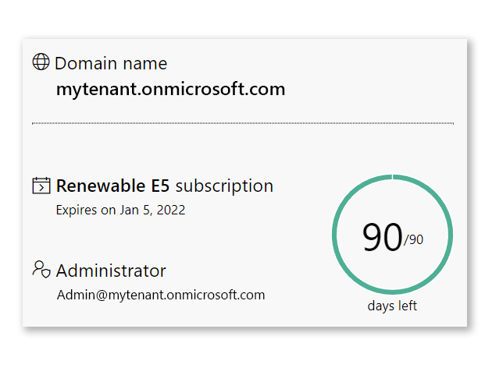
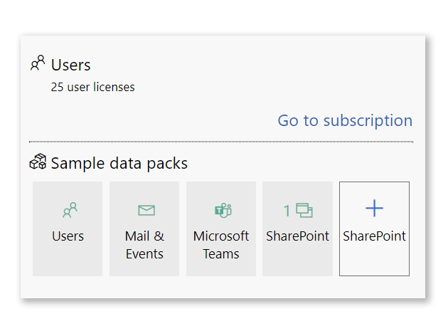
Microsoft 365 Developer Program https://developer.microsoft.com/en-us/microsoft-365/dev-program
Free sandbox to perform testing / QA / training / learning
90 day RENEWABLE Microsoft 365 E5 developer subscription
Sample data packs (users, user data, etc) pre-populated so you can jump right in to testing things such as compliance, security, user administration, etc
Includes 25 user licenses for E5, 16 sample users already setup
Includes all Office 365 apps, Power Platform, 365 ATP, EMS (compliance, information protection, Intune)
Azure AD – test out things like Conditional Access, MFA, and other IAM solutions
IT’S FREE!!! You can setup a complete lab with Config Manager and Intune
We all have a test environment. Some of us are also lucky enough to have a production environment. - Johan Arwidmark

Slide 10
SCCM Lab Kits
Microsoft has a lab kit available… it’s meh
https://www.microsoft.com/en-us/evalcenter/evaluate-mem-evaluation-lab-kit
Johan Arwidmark Hydration Kit
Windows Server 2022, SQL Server 2019, ConfigMgr Current Branch
Good training / documentation & easy to setup
https://www.deploymentresearch.com/training/ ← BEST training for ConfigMgr & Intune
https://www.deploymentresearch.com/hydration-kit-for-windows-server-2022-sql-server-2019-and-configmgr-current-branch/

Slide 11

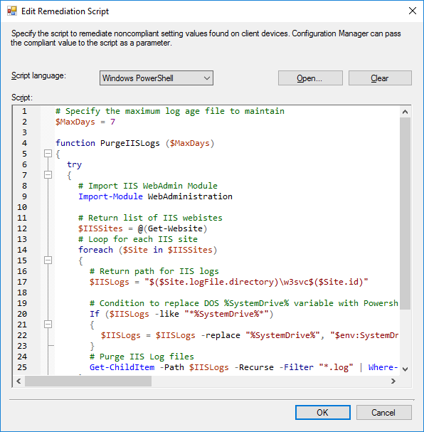
IIS Log Cleanup by Johan Arwidmark (and others) (Twitter @jarwidmark) (https://www.deploymentresearch.com/a-little-bit-of-configmgr-housekeeping/)
Cleans up your IIS logs before they clean you up at the least convenient time possible
Where are IIS logs by default? The #$%&ing C drive.
Delete IIS logs over ___ days old
Configuration Item / Configuration Baseline method or Scheduled Task method
Use CI method… make a collection for all IIS servers (or just Config Manager servers) and target a CI at them
Set it and forget it… unless you want to add on a Teams alert for when it runs
NWSCUG recording coming soon on other ConfigManager maintenance tips from Johan

Slide 12

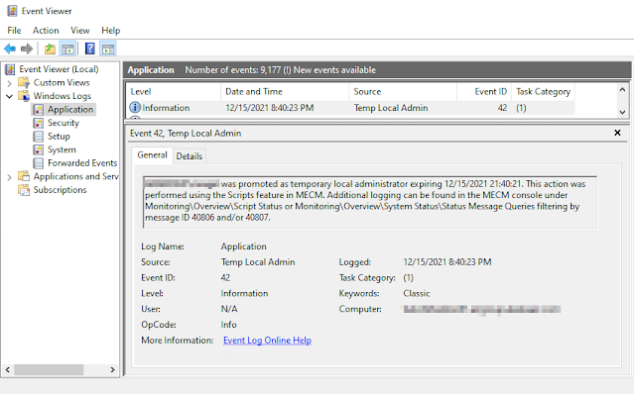
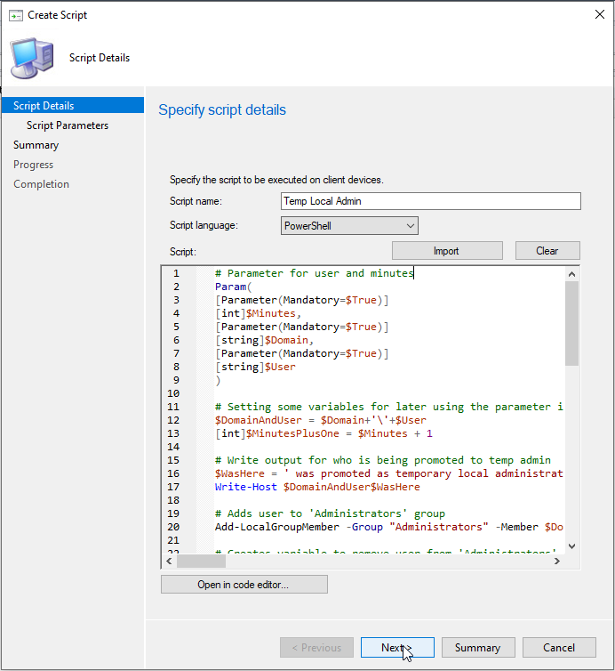
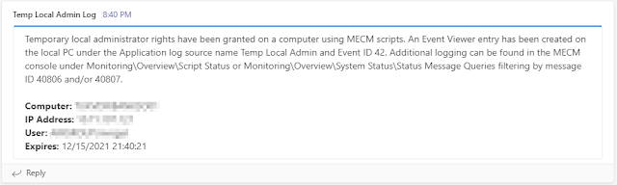
Temp Local Admin by Rudy Bankson (Twitter @Physx51) (https://www.get-itguy.com/2021/12/temp-local-admin-through-mecm-run-script.html)
Temporary Local Admin script for SCCM Scripts
Sets a user as a local admin for a variable amount of time between 1 and 240 minutes
Scheduled Task created to remove local admin rights at variable time and self destruct Scheduled Task once it is done
Event Viewer > Windows Logs > Application logs the action as Event ID 42
Teams Notification to Teams Channel using Incoming Webhook
DANGER: Admins can delete or modify Scheduled Tasks!!!

Slide 13

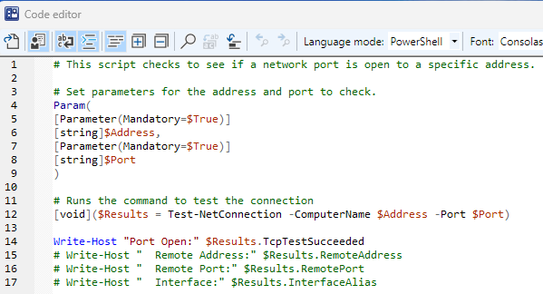
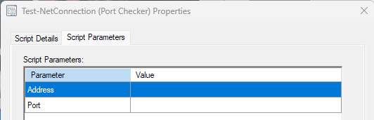
Test-NetCOnnection script by Rudy Bankson (Twitter @Physx51) (https://github.com/rudybankson/ConfigManager-Test-NetConnection )
Tests connections to an IP and port
Modern day Telnet for “pinging a port”
Runs through the Scripts feature of SCCM
Realtime results written back to Scripts monitoring
Just like all other BGB client notification channel actions, this runs on 42 computers at once until it is done on all of them
400 computers recently took me less than 30 seconds to get all results back

Slide 14

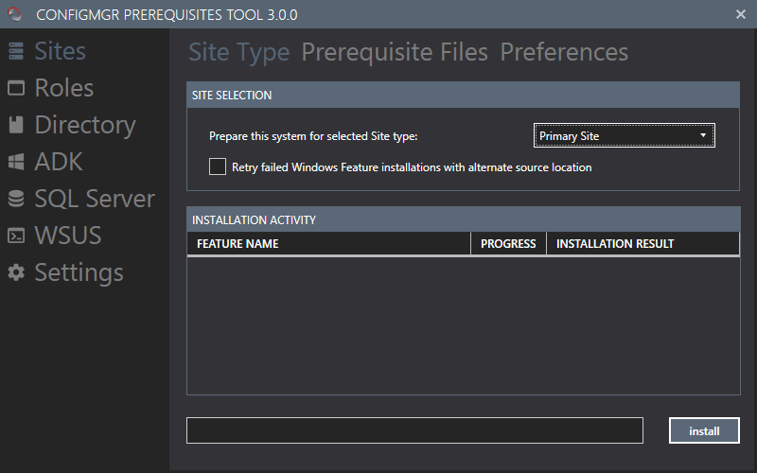
ConfigMgr Prerequisites Tool by Nickolaj Andersen (Twitter @NickolajA) (https://msendpointmgr.com/configmgr-prerequisites-tool/)
Configures Pre-Reqs for SCCM servers
Configuration Manager configuration:
Download prerequisite files for Configuration Manager setup
Download and install Windows Assessment and Deployment Kit (ADK)
Create NO_SMS_ON_DRIVE.SMS files to prevent unwanted volumes to be used by Configuration Manager
Active Directory configuration:
Extend Active Directory schema
Create System Management container in Active Directory
Configure permissions on System Management container
SQL Server configuration:
Configure SQL Server memory usage settings
Validate SQL Server collation
Pre-create the Configuration Manager database
Configure SSRS database file size settings

Slide 15

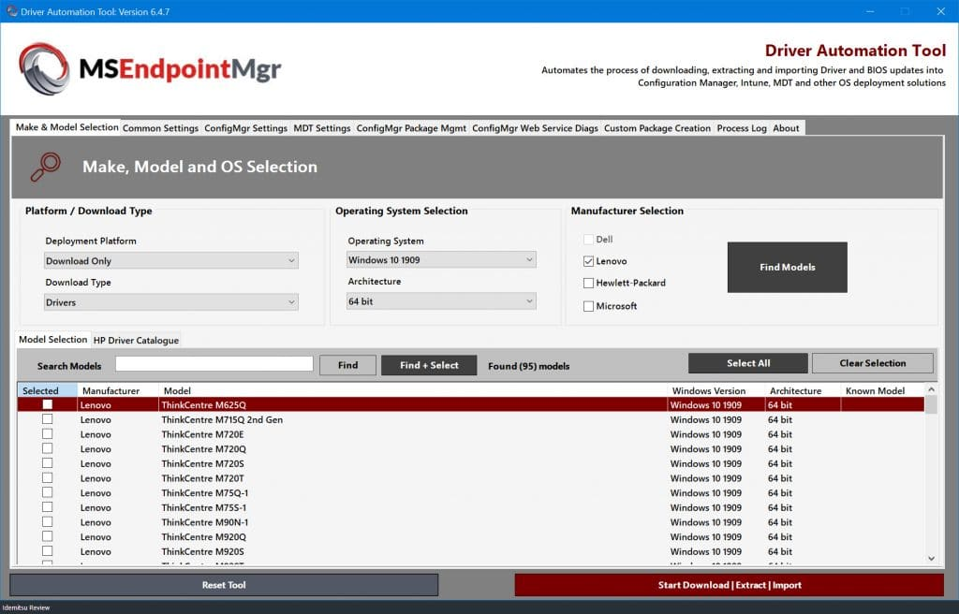
Driver Automation Tool by Maurice Daly (Twitter @modaly_it) (https://msendpointmgr.com/driver-automation-tool/)
PowerShell GUI to download, extract, package, and distribute drivers and BIOS
Support for Dell, Lenovo, HP, and Microsoft hardware
Supports Config Manager and MDT
https://github.com/maurice-daly/DriverAutomationTool
Intune Auto Update Device Drivers: https://msendpointmgr.com/2017/12/04/modern-management-automating-intune-enrolled-device-driver-updates/
https://github.com/MSEndpointMgr/Intune/blob/master/Drivers/Invoke-MSIntuneDriverUpdate.ps1

Slide 16

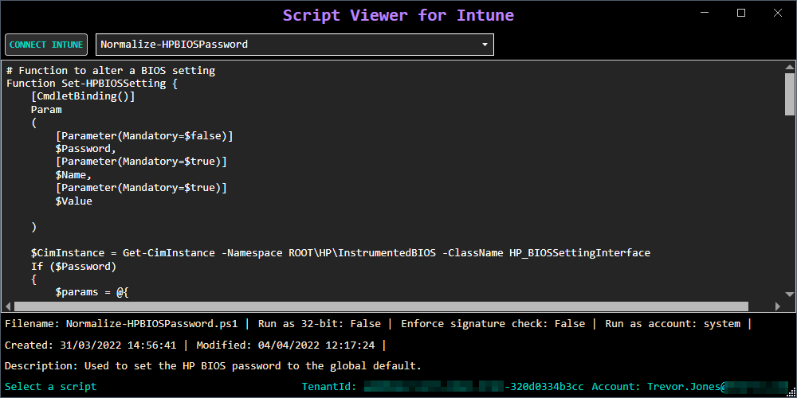
Script Viewer for Intune by Trevor Jones (Twitter @SMSagentTrevor) (https://smsagent.blog/2022/05/11/script-viewer-for-microsoft-endpoint-manager/)
Simple tool to view your PowerShell scripts that are locked away in the dungeons of Intune
There are some requirements / pre-reqs for this to work right… visit the URL at the top to see them all
https://github.com/SMSAgentSoftware/IntuneScriptsViewer/releases
It’s simple, there really isn’t much else to say except for arguing about WHY THE #$%& Microsoft hasn’t given us the ability to do this natively in Intune similar to Config Manager

Slide 17

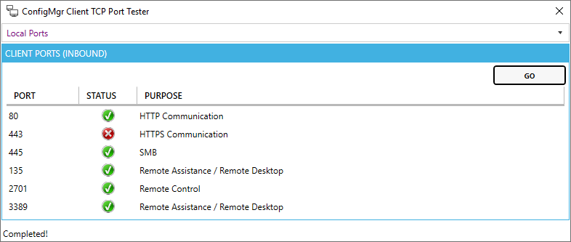

More Gold & Treasure from Trevor Jones (Twitter @SMSagentTrevor) (https://github.com/SMSAgentSoftware?tab=repositories)
ConfigMgr Client TCP Port Tester
This tool is for TCP port testing on SCCM client systems. It checks the local ports required by the SCCM client as well as connectivity to management point, distribution point and software update point servers. In addition, there is a custom port tester for testing any inbound or outbound port to any destination.
https://smsagent.blog/2019/03/07/configmgr-client-tcp-port-tester/
Does not test UDP, did you get it?

Slide 18
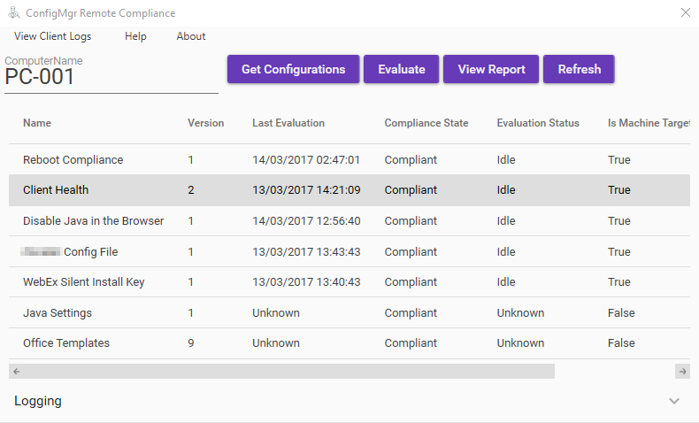

More Gold & Treasure from Trevor Jones (Twitter @SMSagentTrevor) (https://github.com/SMSAgentSoftware?tab=repositories)
ConfigMgr Remote Compliance
ConfigMgr Remote Compliance can be used to view, evaluate and report on System Center Configuration Manager Compliance Baselines on a remote computer. It provides similar functionality to the Configurations tab of the Configuration Manager Control Panel, but for remote computers. It is a useful troubleshooting tool for remotely viewing client compliance, evaluating baselines, viewing the evaluation report or opening DCM log files from the client, without needing to access the target computer directly.
https://github.com/SMSAgentSoftware/ConfigMgr-Remote-Compliance

Slide 19
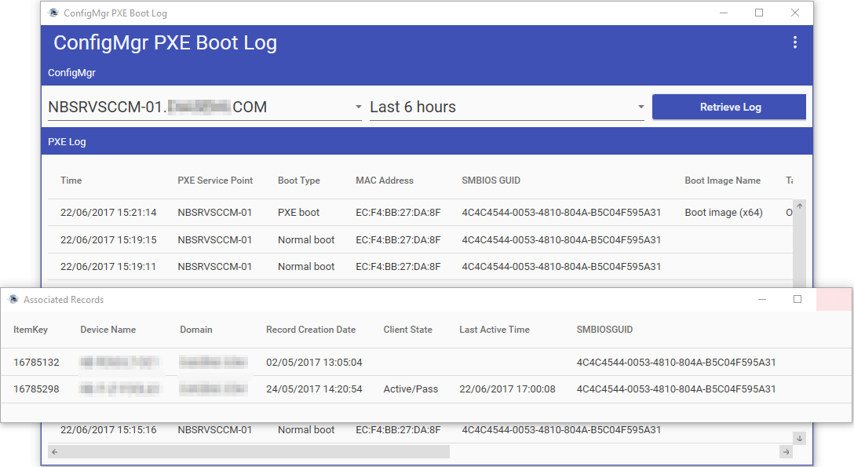

More Gold & Treasure from Trevor Jones (Twitter @SMSagentTrevor) (https://github.com/SMSAgentSoftware?tab=repositories)
ConfigMgr PXE Boot Log
ConfigMgr PXE Boot Log enables you to view PXE boot events on a ConfigMgr PXE Service Point. It can also display any associated records that exist in ConfigMgr for the device that attempted PXE boot.
Answers the question of is that bleeping computer actually hitting the PXE server?
https://github.com/SMSAgentSoftware/ConfigMgr-PXE-Boot-Log

Slide 20
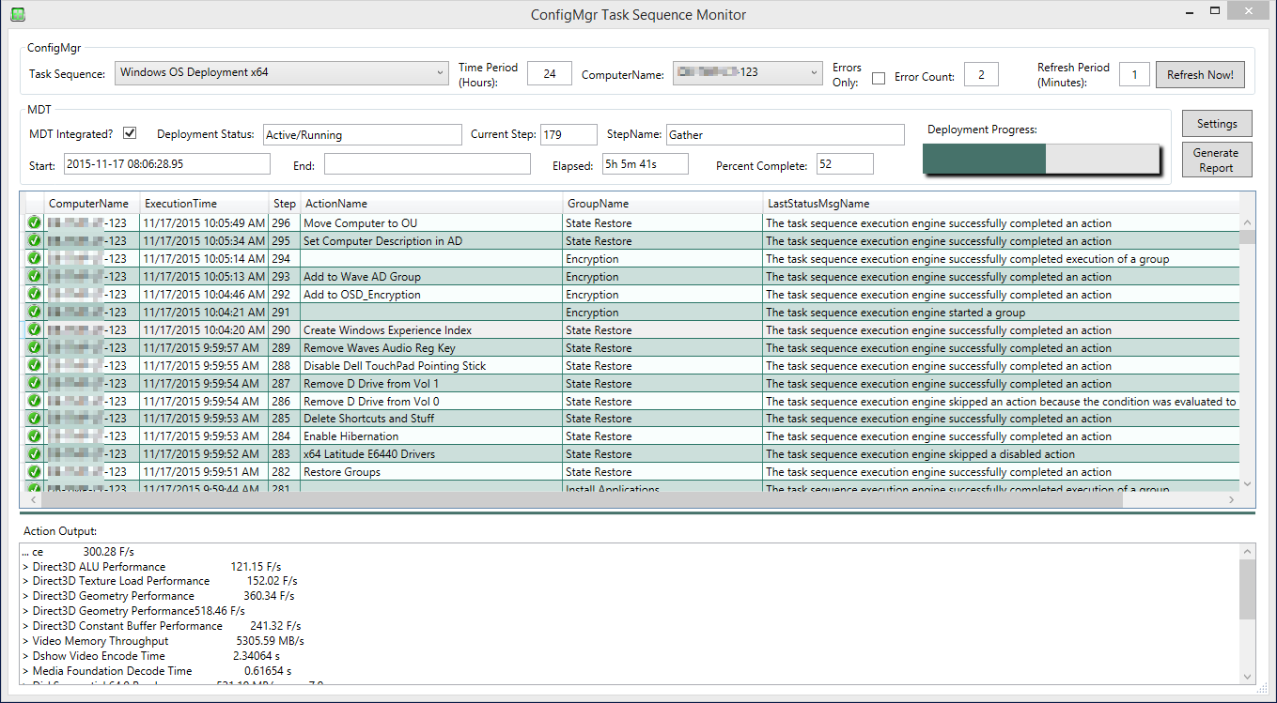

More Gold & Treasure from Trevor Jones (Twitter @SMSagentTrevor) (https://github.com/SMSAgentSoftware?tab=repositories)
ConfigMgr Task Sequence Monitor
Provides real-time monitoring of task sequences similar to the good ol days of MDT where you could see everything in real-time
Can generate an HTML report for a task sequence that was ran on a specific computer
https://github.com/SMSAgentSoftware/ConfigMgr-Task-Sequence-Monitor
https://smsagent.blog/2015/11/17/free-configmgr-task-sequence-monitoring-tool/

Slide 21
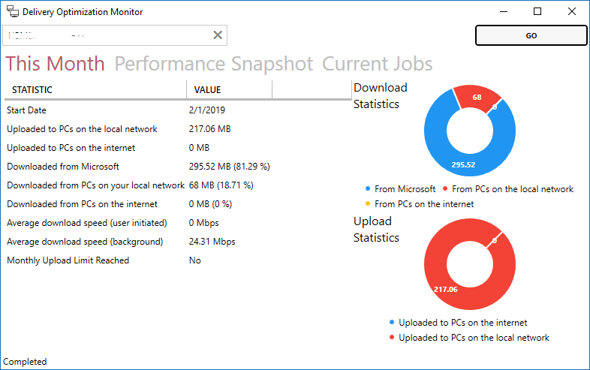

More Gold & Treasure from Trevor Jones (Twitter @SMSagentTrevor) (https://github.com/SMSAgentSoftware?tab=repositories)
Delivery Optimization Monitor
Simple tool to view Delivery Optimization stats on any local or remote computer
https://github.com/SMSAgentSoftware/DeliveryOptimizationMonitor

Slide 22

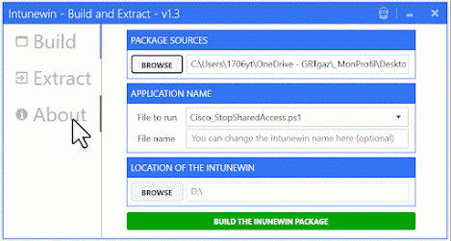
Intunewin Build and Extract from Damien Van Robaeys (Twitter @syst_and_deploy) (https://www.systanddeploy.com/2023/05/intunewin-build-and-extract-tool-to.html)
Tool to build IntuneWinApp packages and EXTRACT existing IntuneWinApp files
This is a PS to EXE tool… it will likely hit as a virus because common AV vendors don’t like it
https://github.com/damienvanrobaeys/Intunewin_Create_Extract

Slide 23

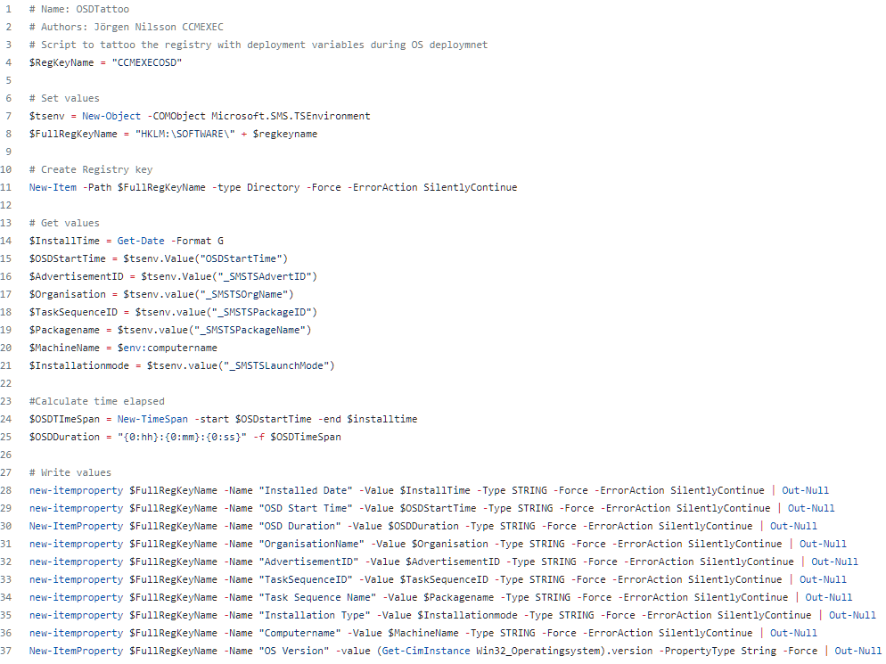
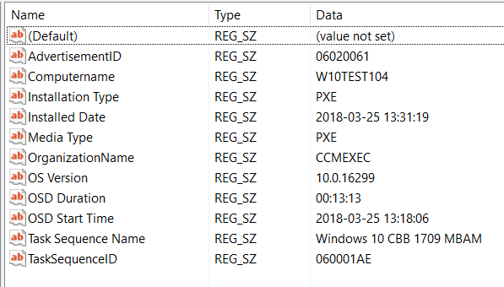
OSD Tattoo from Jörgen Nilsson (Twitter @ccmexec) (https://ccmexec.com/2018/03/script-to-tattoo-the-client-registry-during-osd-ps-version/)
Tattoo OSD build information into the registry as part of the task sequence
Great for a “version history” of a device
Can use RegKeyToMof to add this information to Hardware Inventory for easier reporting
https://github.com/Ccmexec/MEMCM-OSD-Scripts/blob/master/OSDTattoo.ps1

Slide 24

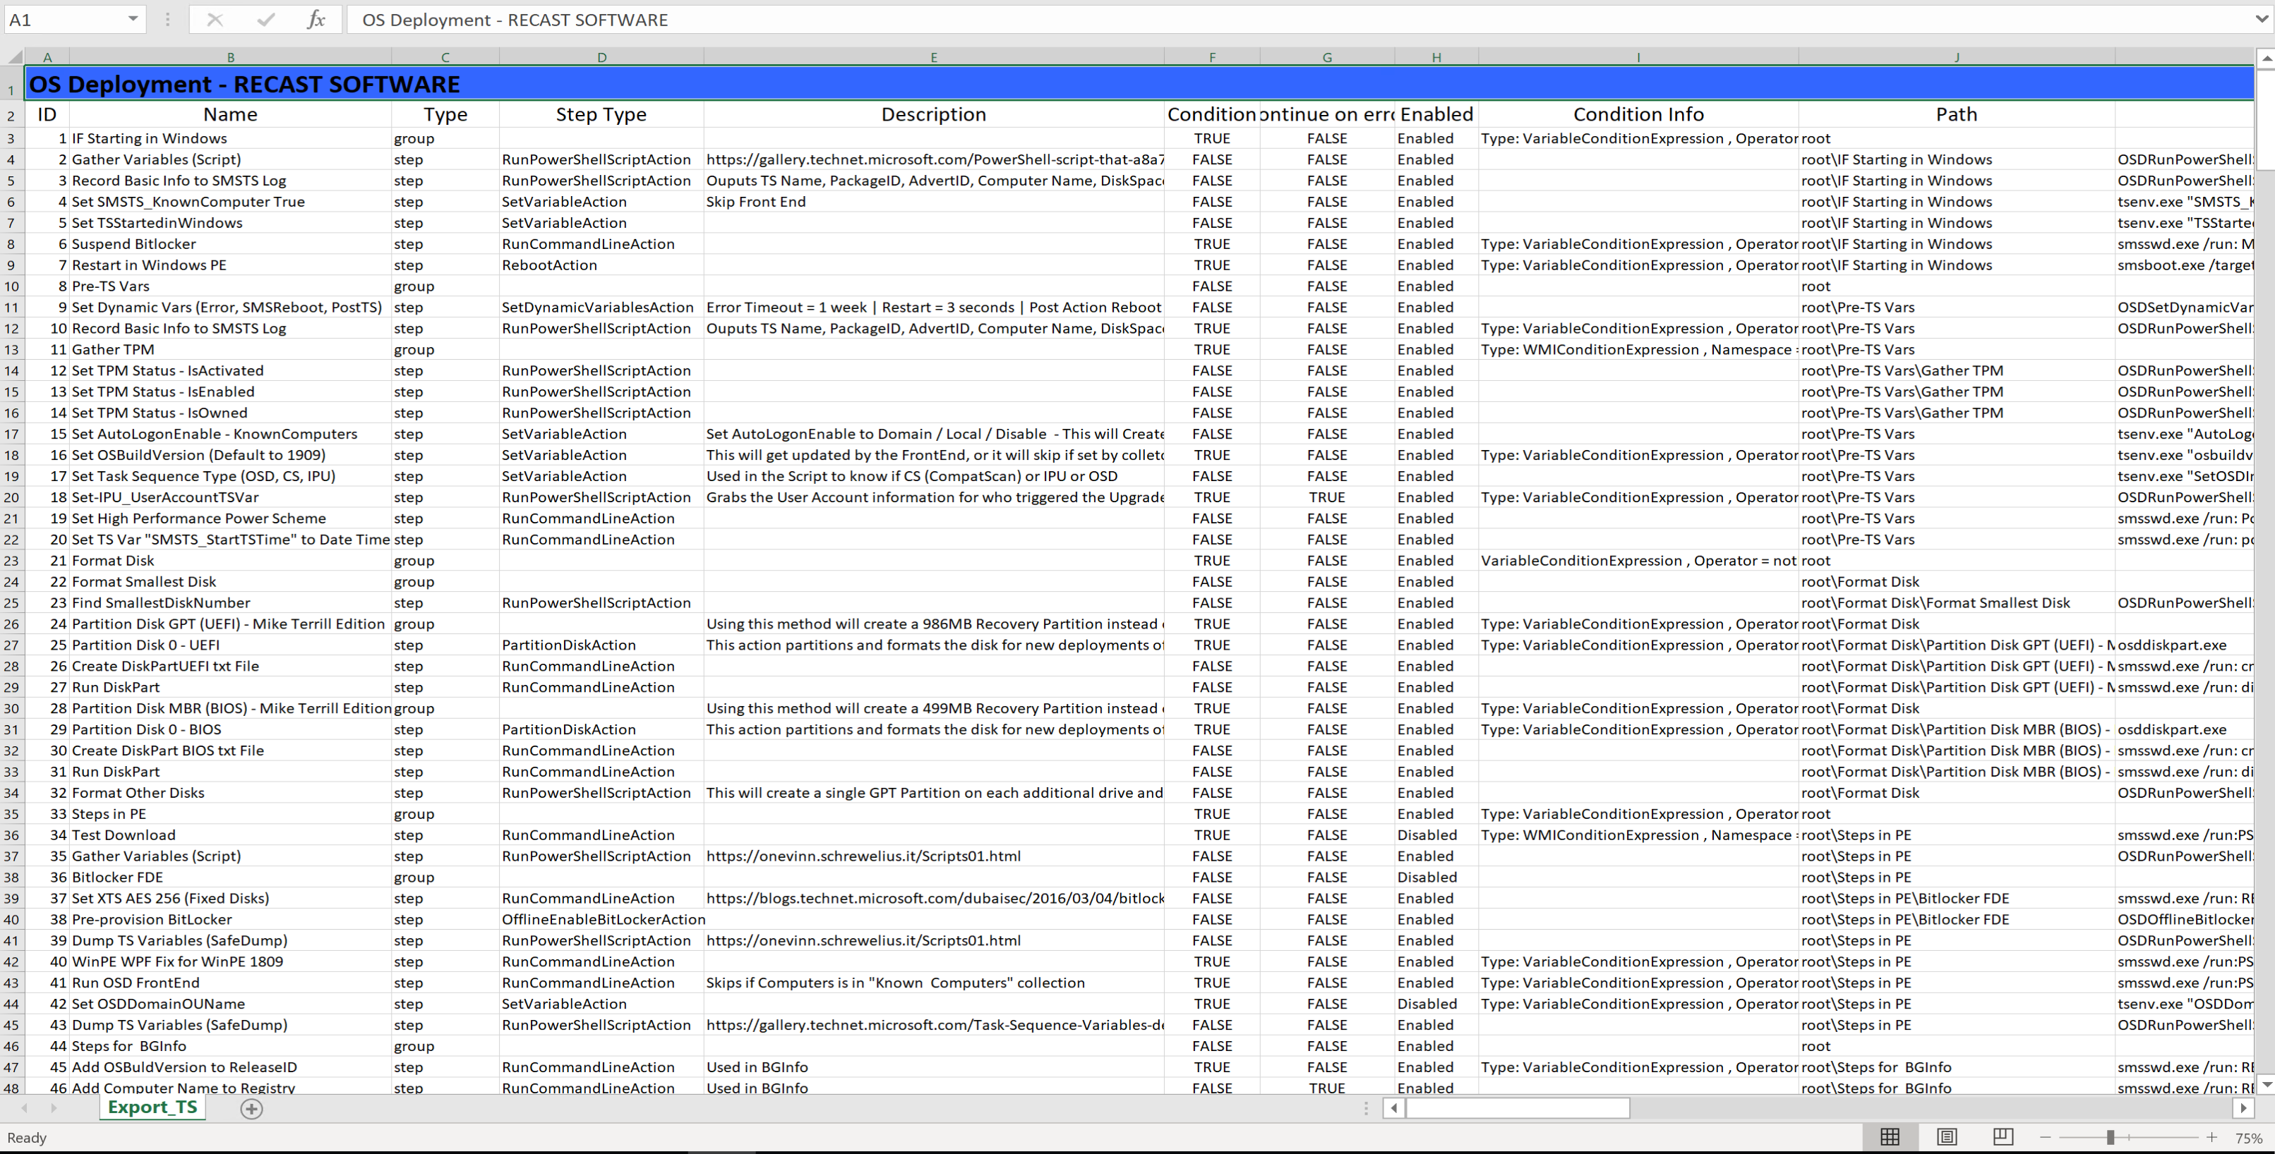
Task Sequence Steps to Excel by Gary Blok (Twitter @GWBlok) (https://github.com/gwblok/garytown/tree/master/TaskSequenceSteps2Excel)
PowerShell scripts to document your task sequences and boot images
General Info about TS
TS reference Items
TS Steps
Dump info about Boot Images
Gary wrote it so it must be good!

Slide 25

Thank You
@Physx51
www.get-itguy.com

